Slide 1















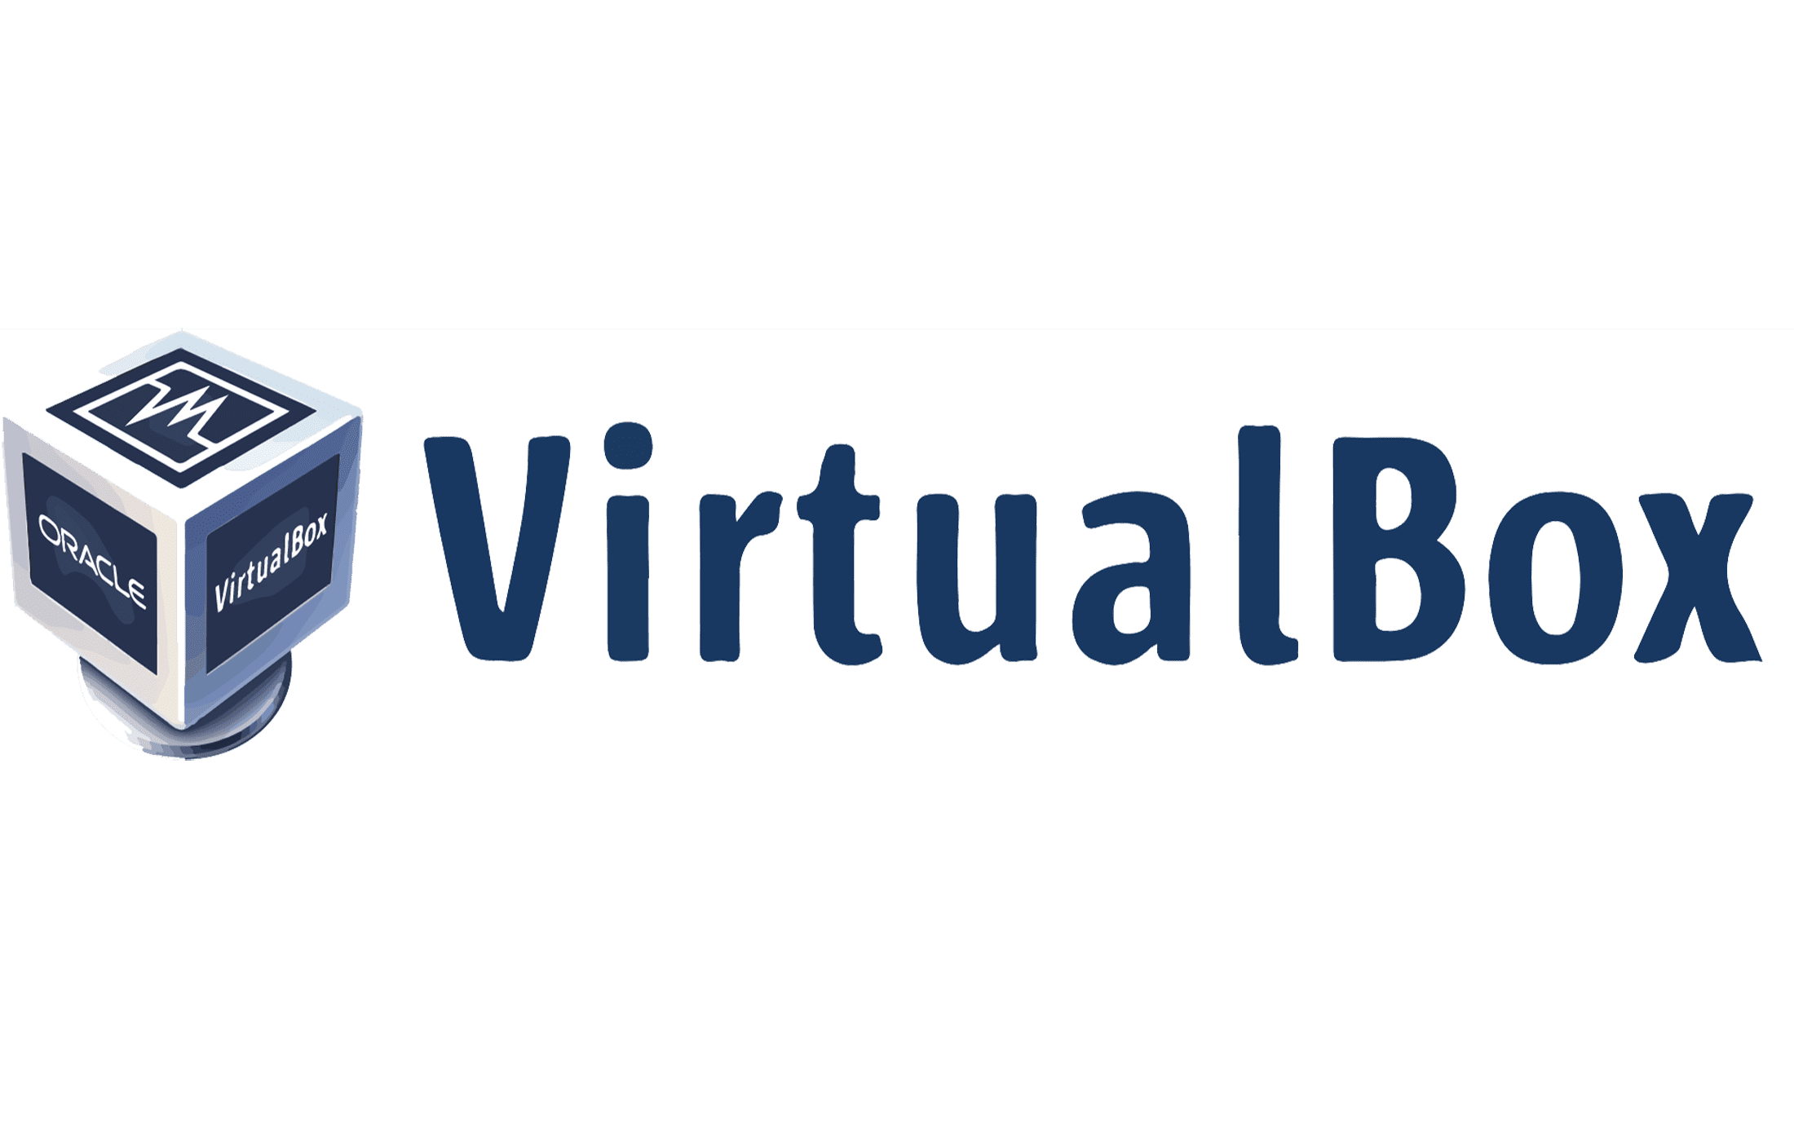








Languages
DB & Frameworks
Library
Tools & Server
APIs

